Slide 1
~ 100,000 TB
Clinical data generated every day — 97% stays locked
Sources: WEF 2024, ExplodingTopics 2025, EdgeDelta 2024, Rivery.io

Slide 2
Why is it locked?
Strict privacy laws
+
risk of patient re-identification
(GDPR / HIPAA / nFADP)

Slide 3


GESALP AI
unlock clinical data — safely
AI-ready data with provable privacy | For hospitals, researchers, CROs, Insurances, pharma & MedTech

Slide 4




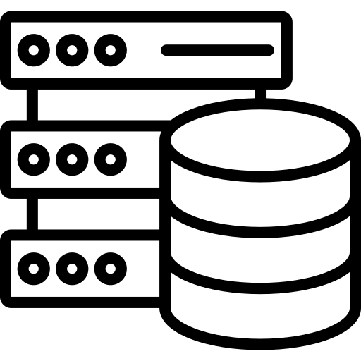

How it works
1
2
3
Upload / Connect
Agentic Engine
Deliver
secure EMR upload
or table link
privacy-ready synthetic data
dataset card & audit report
download the synthetic dataset
& audit report
or publish to the marketplace

Slide 5
Why now?
Nvidia reportedly acquired Gretel,
a San Diego–based synthetic-data startup.
The market is moving now.

Slide 6
Traction
Early inbound demand: pharma-focused GTM firm reached out after discovering Gesalp AI
Signal: Market pull is already starting before launch.

Slide 7
Current Status
Between POC and MVP – gesalpai.ch

Slide 8

Team
Kogulan Natarajan — Founder
AI, Data Engineering & Frontend Development (8+ years)
Paris-based (entrepreneur visa), preparing Swiss relocation
Building clinical-grade synthetic data engine
Looking for
• Swiss co-founder • Angel investor • Clinical/privacy advisors
• Currently in discussion with healthcare & clinical experts to join as advisors

Slide 9
The Ask
Angel funding
to complete the MVP of our agentic synthetic-data engine
and launch early pilots with hospitals & researchers.

Slide 10
Valuation
open to discussion with lead investor.
Raising CHF 100,000 (SAFE - Simple Agreement for Future Equity)

Slide 13
What we do
GESALP AI generates clinical-grade synthetic health datasets
with built-in privacy, ready for research & AI development.
For hospitals, researchers, CROs, Insurances pharma & MedTech.

Slide 14
Why we win
Built for healthcare from day one
On-prem deployment
Agentic engine automates tuning + audit
Privacy + utility validation built-in
Swiss trust advantage

Slide 15
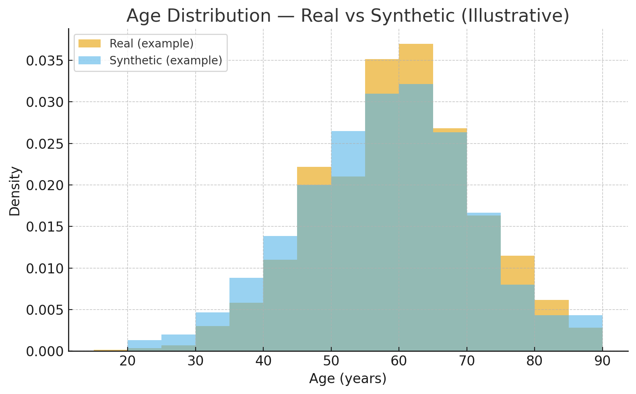

Slide 16
MIA AUC (0.560)
“MIA” = Membership Inference Attack
AUC ≈ 0.5 means the attacker cannot tell if a real patient was in the original dataset.
0.560 is very close to random guessing — this is considered safe.
“0.56 means an attacker is basically guessing. They can’t tell whether a patient was in the dataset.”

Slide 17
Duplicate Rate (3%)
This checks how many synthetic records accidentally match real patient records.
✅ Simple version:
“Only 3% look similar to original rows — meaning no direct copying. This is considered safe in synthetic data tests.”

Slide 18
Utility Audit (Passed)
This proves the synthetic dataset is useful for analysis, AI, or statistics.
• KS Mean (0.080)
KS = Kolmogorov-Smirnov distance, a measure of how close distributions match.
“0.08 means the synthetic distributions closely match the real ones — good utility.”
• Correlation Delta (0.120)
This checks if relationships between variables (e.g., age → blood pressure) are preserved.
“0.12 means the relationships in the synthetic data closely match the real data — useful for AI training.”

